Slide 1
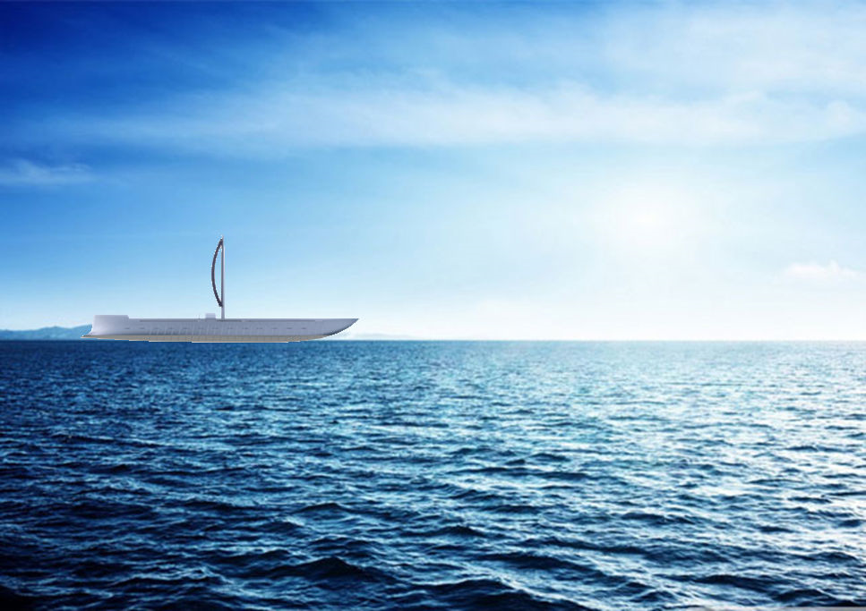


EBA’s e-Penteconter
Inspired by the Antiquity to Face Today’s Environmental Challenges
Blue Growth aims to inspire and help young entrepreneurs realize their innovative concepts relating to marine and freshwater resources.
4/12/2017

Slide 2

Electric Boat Association of Greece
Non-profit organisation, founded in 2016 to:
Promote the development of electric boating in Greece at local, regional, national, EU and international levels
Promote either electrically driven or hybrid boats and ships, using sustainable energy resources thus protecting the environment
Establish a network that connects all those having an interest in electric boating: manufacturers, boat owners and EBA’s partners

Slide 3







EBA’s Members
& Partners

Slide 4
The Problem
  The pain point addressed by the association:
  In Greece, the green technologies are still generally perceived as too complex and costly to be used
  No electric boats and ships built, sailing or even allowed to sail in Greek waters
  Why are current solutions inadequate?
  No convincing example of the use of green technologies to power boats exists in Greece

Slide 5
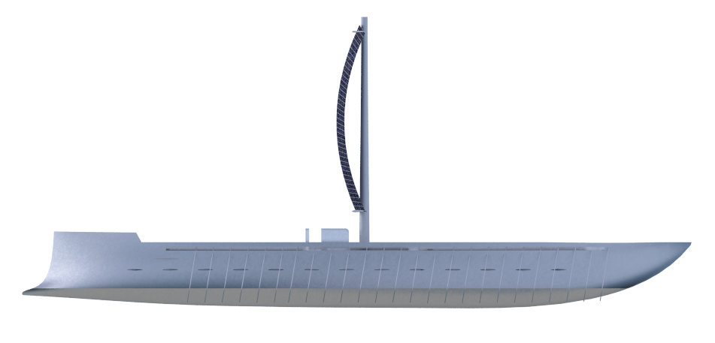
The Solution
e-Penteconter
A new type of boat, inspired by the Antiquity
to face today’s environmental challenges

Slide 6
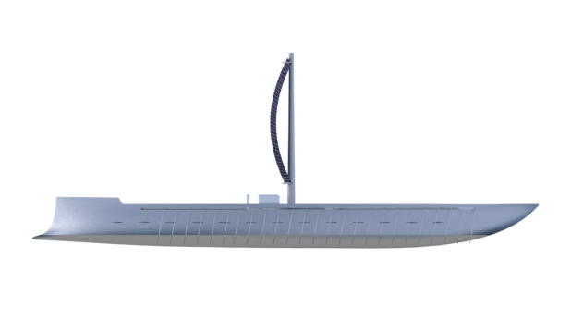
The e-Penteconter
Inspired by an ancient Greek sail boat of the 7th century BC with 50 rowers: 25 port, 25 starboard
Will be built with light materials:
  Carbon Fiber
Completely autonomous, powered with:
  Solar Panels
  Solar Sail
  Electric Engine & Batteries using Solar Energy and Kinetic Power provided by the manpower (50 rowers)
A potentially ideal Flagship to Celebrate the 2500 years of the Battle of Salamis

Slide 7
… more than an idea
The e-Penteconter was selected by the SMILIES project of EU MED program as its Flagship pilot in partnership with:
  The Aegean University’s Industrial Design Dept in Syros
  The incubator ARCA of the University of Palermo.
It has been recognized as the best practice by Creative MED project for its innovative potential in the Mediterranean area
Key milestones achieved:
  Design and drawings, for both exterior and interior, integrating latest environmentally friendly marine technologies
  Communication tool set (domain names and video)
  Initial business plan

Slide 8
The e-Penteconter
Construction Budget
Expenses | Millions €
Design and classification: Elegant, Safe, Environmental friendly, High-Tech | 0,5
Interior design: 28 cabins + common spaces | 0,5
Light-energy saving, hydrodynamic structure: Carbon fibre hull, weight<20 T | 1,5
Electrical engine and batteries, water desalinating system, safety | 1,0
Futurist deck: 50 removable rower seats with production of electric energy from kinetic movement, solar sail, flexible and fixed solar panels | 1,5
Total estimated cost: | 5,0+VAT
Revenues
Buzz phase: Before and during the building: (3 years – 0,15 Mio €/year): Fans Community subscriptions/crowd funding (dream together on functionalities/uses), Sponsors and advertisers | 0,45
Construction phase (2 years – 0,5 Mio €/year) Rights of diffusion, Revenues of Events, Sponsorship, guided visits | 1,0
Total | 1,45

Slide 9
The Competition
No direct competition has been identified so far. The e-Penteconter is energetically self-sufficient using:
  Sail
  Solar Energy & Electric Motor
  Kinetic Energy (Rowers)
She can become a great Ambassador of electric boats & ships as well as of eco-friendly technologies, enhancing environmental awareness while joining past and present history

Slide 10
The Market
Estimate of Total Addressable Market (TAM): the Mediterranean Sea & Overseas
Several uses can be foreseen:
  As a flagship in celebrations: in Piraeus as a example of its dynamism and a source of inspiration for new marine innovations, Salamis historical battle, a link with Niarchos Cultural Center, Eleusis as European Capital of Culture, Magna Grecia, Marseille (from where Pytheas sailed to Northern Europe)
  As a cruising and sports platform between different ports in the Mediterranean sea in Greece, Italy and France
Supporting data and evidence:
  Adventure Tourism is a growing market¹. It is expected that global adventure tourism market will grow at an annual rate of 46% until 2020².
1: Global Report on Adventure Tourism, World Tourism Organization 2014
2: Global Adventure Tourism Market 2016-2020, Sandler Research, Code: MRS - 81659

Slide 11
The e-Penteconter Financial sustainability
Exploitation phase | Millions €
 | Expenses | Revenues | TOTAL
Running cost and maintenance | 1,9
Revenues: Chartering for thematic cruises (athletic, environmental, cultural); Receptions and corporate events; Use as platform for innovative technology exhibitions, demonstrations, cultural events and performances |  | 2,2
TOTAL | 1,9 | 2,2 | 0,3

Slide 12
Impact
Environmental benefits
  Zero environmental impact
  Platform for R&D in sustainable yachting and renewable energies
  Collecting data in marine biology
Social benefits:
  Give life to the Greek shipyards with new naval constructions
  Provide opportunities for SMEs and Start-Ups to promote innovative services, solutions and products
  Become a meeting point for innovative educational and technological programs, sport and cultural events
  Create new qualified jobs and volunteering opportunities

Slide 13
Next Steps
Next 6 months steps; if you have 50K what you would do first?
  Start detailed building plans
  Further development of our business plan and market study
  Enhance the web presence (website, social media, crowd funding)

Slide 14
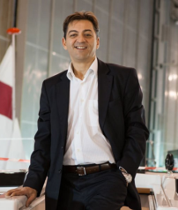
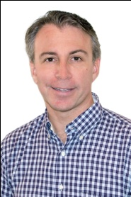
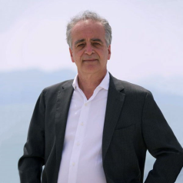
The Core Team
  Andreas Apostolopoulos (GR), Energy Solutions Manager of the Project, Electrician & Aerospace Engineer from the ATEI Chalcis, CEO of ILIOFOS Co ltd. specialised in electric motricity and production solutions, Chairman of EBA.
  Alexis Daras (GR-FR), Leader, Promoter and Inventor of the Project, graduate in International Relations & Interpretation (FR), Consultant for Tour Operators, Program Director for Yachts, Cruises & River Cruises, Member of the Board of EBA and Associate Partner of CEDECS Ltd (FR)
  Athanase Contargyris (GR), Financial and Exploitation Manager of the Project, Master in Management Sc. of ΗΕC (FR) and graduate in Law (FR), senior expert in European R&D and innovation projects and on SMEs support, Member of the Board of EBA, Founder and General Manager of DIALOGOS Ltd (GR) and CEDECS Ltd (FR)
  Key associate members: EBA’s members & partners & CEDECS
Notes:
Alexis Daras, Member of the Board of EBA, Leader and Inventor of the Project, graduate in International Relations & Interpretation (FR), Consultant for Tour Operators, Program Director for Yachts, Cruises & River Cruises

